Slide 1
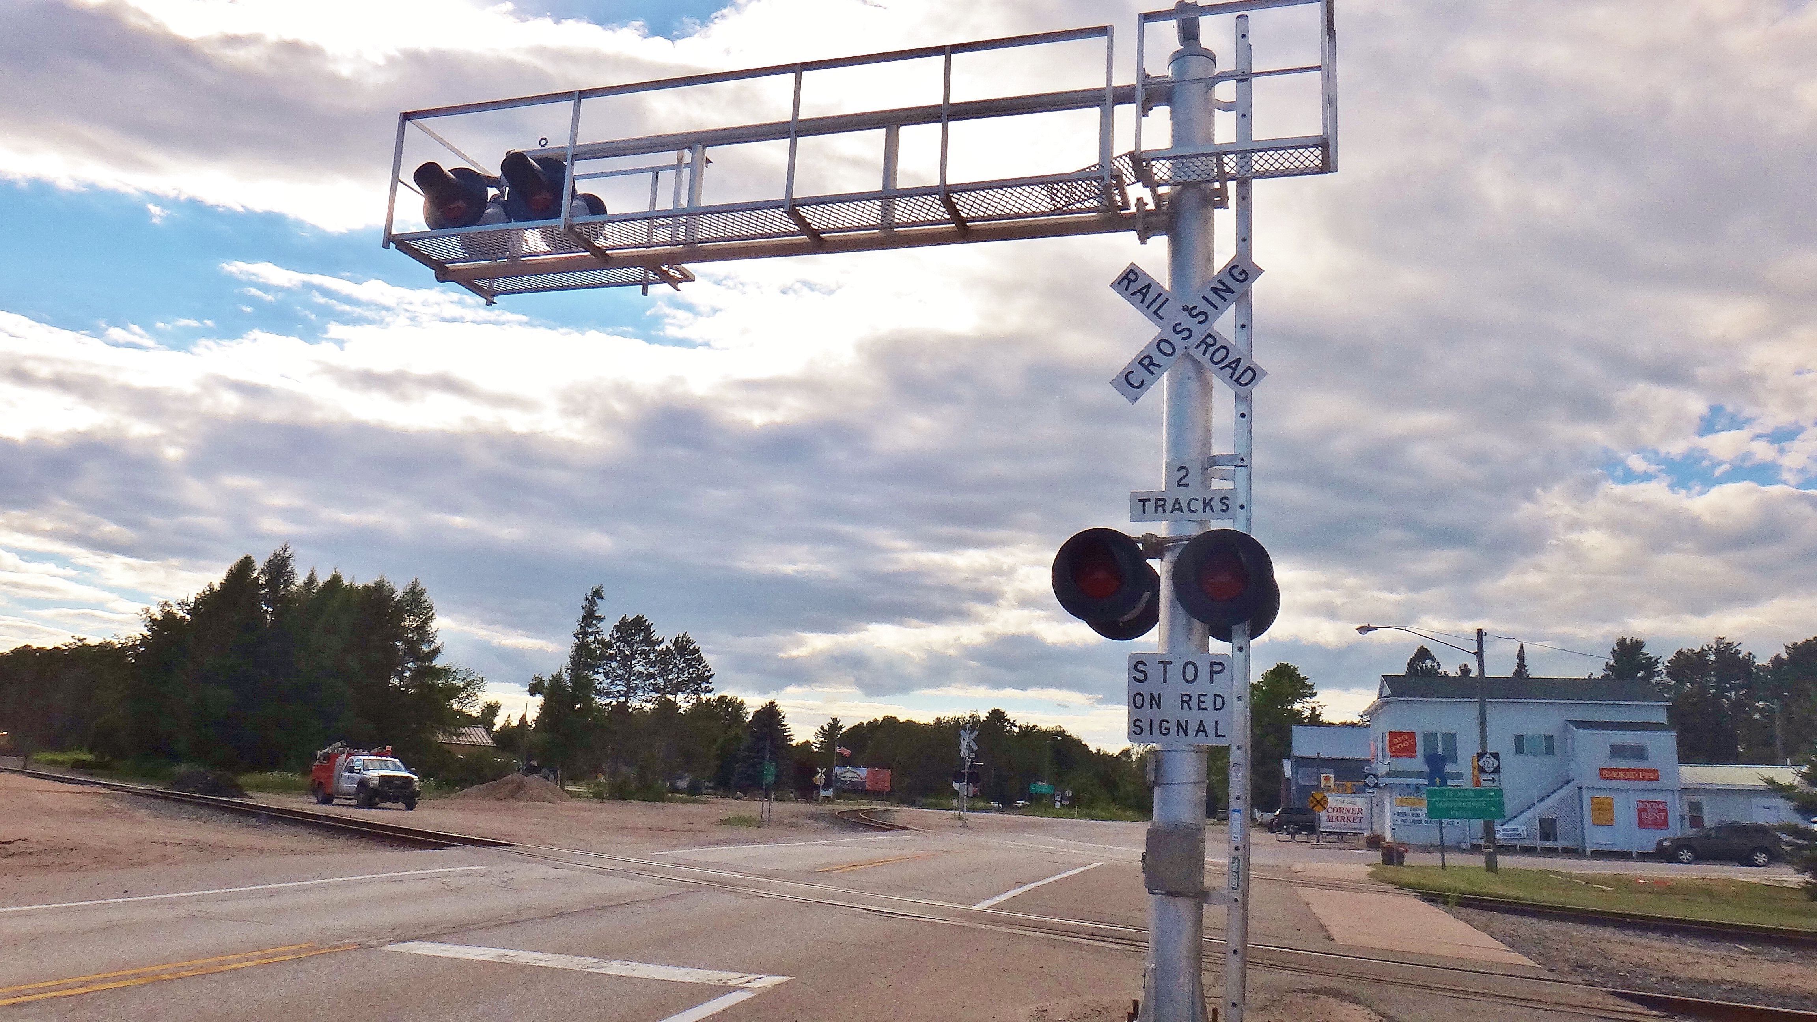
Detection of Warning Bells at Level Crossings
Unina – Machine Learning 21/22 – Mini Contest 3
Benfenati Domenico– M63001165

Slide 2






Machine Learning Process
Business understanding
Data understanding
Data preparation
Modeling
Evaluation
Submission
Business understanding

Slide 3

Machine Learning Process
Business understanding
Data understanding
Data preparation
Modeling
Evaluation
Submission
Business understanding

Slide 4



Business Understanding
Data acquisition
Sound detection
Sound classification
Detect whether a given sound sample belongs to a warning bell at level crossings or not
Notes:
Fase 1: acquisire i suoni
Fase 2: calcolare lo spettrogramma
Fase 3: classificare I suoni dello spettrogramma

Slide 5
Tools
Python
Pandas
Matplotlib
PyTorch
Colab
Software tools used to face the problem

Slide 6

Machine Learning Process
Business understanding
Data understanding
Data preparation
Modeling
Evaluation
Submission
Data understanding

Slide 7
Data Understanding
Sample
The mel-spectogram data of the sample
One Hot Encoded Class
The categorical class
Warning Bell = [1 0 0]
No Alarm = [0 1 0]
Generic Alarm = [0 0 1]
Each training samples is characterized by different attributes

Slide 8
MEL-Spectrogram
Signal
Apply the FFT to obtain the frequency shape of the signals, using some overlapping windows
Spectrum
Convert the spectrum into a logarithmic scale and obtain the spectrogram
Spectrogram
Convert the spectrogram into the MEL- scale and obtain the MEL-spectrogram
Mel-Spectrogram
Collect all value of the spectrogram into the arrays
It is a (96*#sec) x 64 elements matrix, where each 96x64 sub-matrix corresponds to 1sec in the original audio

Slide 9
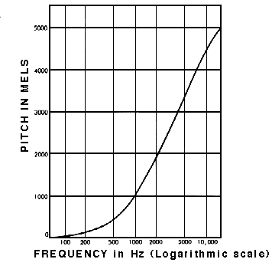
MEL-Spectrogram
Input signal
Spectum
Spectrogram
MEL-Spectrogram

Slide 10
Data Understanding
The training set is quite balanced in term of class
And also the validation set

Slide 11
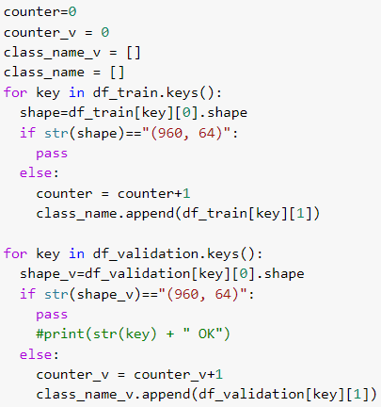
Data Understanding
If we consider each MEL-spectrogram as a row array, we can see what istances are shorter. Each samples that have a shorter spectrogram, is related to the class 2
Training and validation set situation

Slide 12

Machine Learning Process
Business understanding
Data understanding
Data preparation
Modeling
Evaluation
Submission
Data preparation

Slide 13
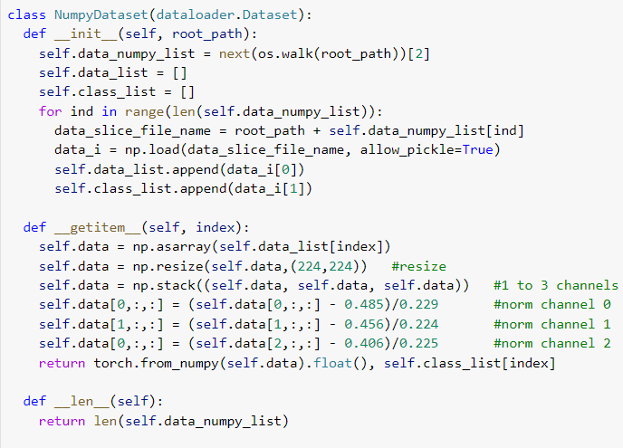
Data Collection
In order to read the dataset, create a class that extract the information in the Numpy Arrays, normalize them using the weight of the Alex Net and then apply the normalization on the three channels
Resize the data using the Alex weight
Split the data in 3 channels
Normalize the channels using the alexnet weight

Slide 14
Data Preparation
Dataset
Training set (labeled)
Training set (84%)
Test set (16%)
Test set (unlabeled)
Submission
Evaluation
Hyperparams Tuning
Competition
Training set (68%)
Validation set (16%)
Apply a simple holdout, to create a local test set using the train istances

Slide 15
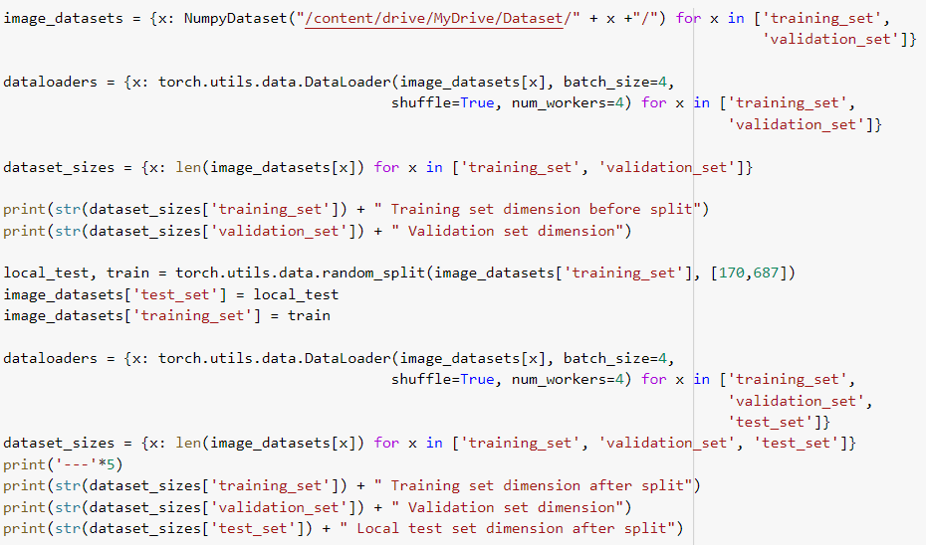
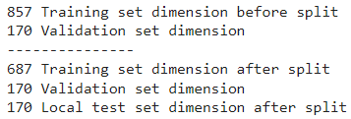
Data Preparation
Read the data in the drive folders
Given the split already made, and the near balance of the data in the training set provided, it was decided to derive the local test set from the training by doing a random split
Split the train data in train and local test part
Create the dataloaders for train, validation and test
Dimension of the dataset

Slide 16

Machine Learning Process
Business understanding
Data understanding
Data preparation
Modeling
Evaluation
Submission
Modeling

Slide 17
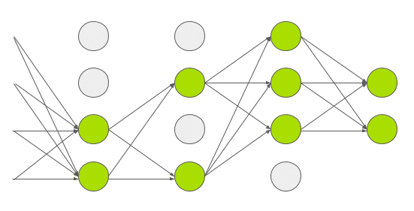
Modeling
AlexNet
Consider the Alex Net pretrained Convolutional Neural Networks (CNNs), provided by PyTorch
5 convolutional layers
Dropout
3 dense layers
Dropout methodology consists in random link elimination among the fully connected layers

Slide 18
Modeling
Set model’s hyperparameters
Train the model (training set)
Evaluate model’s performance (validation set)
Plot the learning curves (loss and accuracy)
The modeling process can be synthetized as an algorithm

Slide 19
Training Process
Set model’s parameters
(Learning rate and batch size)
For all epochs, divide the dataset in batch
For all batches, compute the loss and the gradient
Evaluate the performance on the validation during the epoch
The train process consists in some phases

Slide 20
Hyperparameters Tuning
Hyperparameter | Description
Batch size | Size of mini batches
Number of epochs | Number of training epochs
Loss function | Function to minimize during training
Optimizer | Optimization algorithm used for training
Learning rate | Learning rate used by the optimization algorithm
Tune the hyperparameters evaluating model’s performance on validation set

Slide 21
Ex: Tuning the Learning Rate
Low learning rate
Good learning rate
High learning rate
A good batch size is regarde

Slide 22
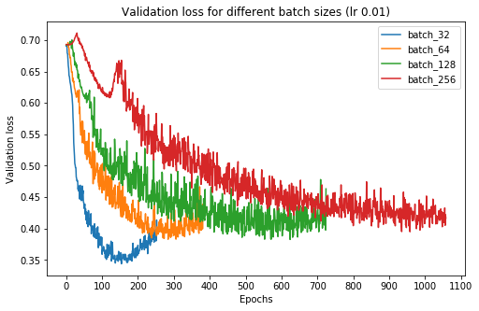
Ex: Tuning the Batch Size
A batch size is an important parameter as well.
It depends on the learning rate: if the loss is calculated on too many instances, the network may not improve at all, but if it is calculated on too few instances, at each epoch I have a high change in loss at each epoch and I have a lot of fluctuations on the loss

Slide 23
Ex: Tuning the Epochs
A good value of the epoch can be chosen look at the loss graph on the training and the validation set.
A good choice for the number of epochs is the value after which the loss curve on validation begins to rise
Bad number of epoch
Good number of epoch

Slide 24
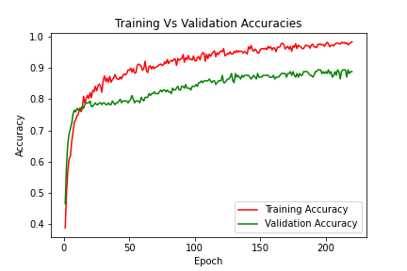
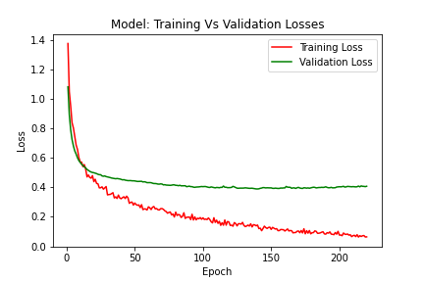
Final Hyperparameters
A Learing rate of 0.000001 can provide us the best training curves.
During the training process of the net, I save the hyperparameters and, at the end of the process the best loss value was obtained at the epoch 195
AlexNet
Hyperparam | Value
Batch size | 120
Number of epochs | 195
Loss function | Cross entropy
Optimizer | Adam
Learning rate | 1e-6

Slide 25

Machine Learning Process
Business understanding
Data understanding
Data preparation
Modeling
Evaluation
Submission
Evaluation

Slide 26
Evaluation
Training set
Training
Hyperparams
Evaluate models’ performance on an independent test set
Model
Prediction
Test set (labeled)
Accuracy

Slide 27
Model Evaluation
After the training process, evaluate the performance of the local test set and see if the performance are good or bad.
 | Accuracy | Loss
Model on best epoch (training set) | 0.9753 | 0.0814
Model on best epoch (validation set) | 0.8941 | 0.3973
Model on best epoch (test set) | 0.9046 | -

Slide 28
Machine Learning Process
Business understanding
Data understanding
Data preparation
Modeling
Evaluation
Submission
Submission

Slide 29
Submission
Training set
Training
Hyperparams
Retrain the model using the whole training set and predict the labels for the instances of the original test set
Model
Prediction
Test set (unlabeled)
Submission

Slide 30
Submission
Training set
Validation
set
After the model selection, combine the train, validation and local test set, and retrain the model for all the on the whole training set, and apply the model on the unlabeled test set
Local Test set
Submission

Slide 31
Final Score
The model with better performance on the test gets also the best score on Kaggle
 | AlexNet
Accuracy (test set) | 0. 9046
Accuracy (public leaderboard) | 0.8898
Accuracy (private leaderboard) | 0.8366

Slide 32

Thanks for your attention!

